Slide 1

Intermediate Git and GitHub
Northwestern IT Research Computing Services

Slide 2
Slides, links, and exercises: https://github.com/nuitrcs/intermediate-git-workshop

Slide 3
Git Branches
Commits are snapshots of the files in a repository with some metadata
Including reference(s) to parent commit(s)
Branches in Git are just named pointers to commits.
master is not special, it’s just the default branch.
HEAD is a special pointer to the most recent commit on the current branch.

Slide 4
Branching Example

Slide 5
Exercise 1: Branching
Create a new folder and initialize a git repository inside it (git init)
Create a file and commit it.
Create and check out a new branch (git branch <name>; git checkout <name>)
Create another file and commit it.
Check out the master branch and merge your other branch into it (git merge <name>)
View commit history (git log --oneline)

Slide 6
Exercise 2: Merge Conflicts
Create and check out a new branch called conflict.
Add 4 lines of text to one of your files and commit.
Check out the master branch, edit the same file, add 4 different lines of text and commit.
Try to merge the conflict branch.
Work out the merge conflict and commit.
View commit log (git log --oneline --graph)
How many parent commits does each commit have?
Delete conflict branch and view log again. What changed?

Slide 7
Using Branches
Don’t commit to master except in very simple projects.
Some projects use long-running “develop” or per-developer branches.
Use per-feature or per-issue branches.

Slide 8
Remotes
A “remote” is a reference to another git repository.
When a repository is cloned, a remote named origin is created by default.
Repositories can have any number of remotes (zero or more).

Slide 9
Remotes
“Tracking branches” are references to the state of branches on a remote and are managed for you. E.g. origin/master
git fetch <remote> gets updates from the remote repository.

Slide 10
Remotes
Commits from a remote are not merged in automatically!
You still need to merge them into your local branches with git merge.
(or use git pull which does fetch + merge)

Slide 11
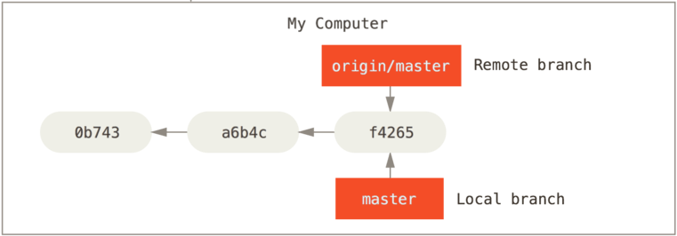
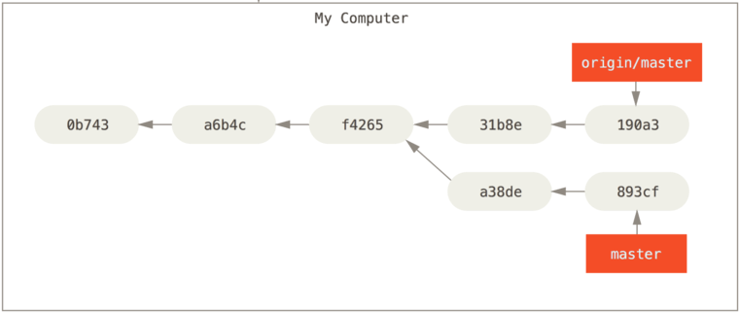
Remote vs. Local Branches

Slide 12
Remote-related commands
git fetch <remote> # gets updates
git merge <remote>/<branch>
git pull <remote> <branch> # fetch + merge
git push <remote> <branch>
git checkout --track <remote>/<branch>

Slide 13
Exercise 3: Remotes
Create a new repository with a README in GitHub.
Clone the repository locally.
In GitHub, edit the README file and save (commit).
Use git fetch to get the new commit. Did your local copy of README change? What is the output of git log and git log --remotes?
Merge in the new commit.
On your computer, edit README again, commit, and push to GitHub.

Slide 14
Rebasing
git merge keeps all commit parents and combines changes together in a new commit.
git rebase calculates changes from one branch and “replays” them on another.
Use rebase to change the “base” of a branch, e.g. when you want to incorporate changes that occurred on master into a feature branch.

Slide 15
Simple rebase workflow
git checkout -b feature # do work
(other commits happen on master we wish to incorporate into feature before merging)
git rebase master feature
git checkout master
git merge feature # fast-forward

Slide 16
Rebasing tips
DO NOT REBASE COMMITS THAT EXIST OUTSIDE YOUR REPOSITORY (I.E. that have been pushed or pulled).
Do use rebase to clean your local history before pushing.
Rebase can also be used to combine, reorder, and remove commits.

Slide 17
Exercise 4: Simple Rebase
In any local repo, create and checkout a new branch called feature
Create a file and commit to the feature branch.
Check out master, create another file, and commit.
Switch back to feature and rebase it onto master (git rebase master feature)
Check out master, and merge the feature branch back in. Did git use a merge commit or did it fast-forward?

Slide 18
Changing History
Sometimes you need to undo a previous commit.
git revert creates commits that undo changes in previous commits.
git rebase -i allows you to remove commits from your repository’s history.
You must use the -f (force) to push after removing commits with git rebase. Be careful!

Slide 19
Exercise 5: Removing Commits
In any local repo, create a file called “sensitive.txt” and commit.
Edit a different, non-sensitive file and commit again.
Use git rebase –i <commit> to remove the commit that created the file sensitive.txt.
Run git log --oneline --graph --all. What happened to the first commit? Was the other file you edited affected by the rebase?

Slide 20
GitHub Issues
Issues in GitHub are a place to discuss problems, bugs, feature proposals, etc.
They can have assignees (people responsible for fixing) and labels (“bug”, “enhancement”, “help wanted”, etc.)
Many other GitHub features integrate with Issues.

Slide 21
Exercise 6: GitHub Issues
In a GitHub repository you own, create an issue and assign it to yourself. Copy the issue number.
Clone the repository locally (if you haven’t already) and create a branch for your issue.
Create a commit on that branch, and include “Closes #<issue number>” in the commit message. (e.g. “Closes #1”)
Check out master and merge in your issue branch, then push.
Check the issue in GitHub. Did anything change?

Slide 22
GitHub Forks
A Fork in GitHub is a repository that is a copy of an “upstream” repository, and can track changes in the upstream repository.
Useful for contributing to large projects, or making your own customizations to a project.

Slide 23
Exercise 7: GitHub Forks
Create a fork of nuitrcs/github-playground in your own account and clone the fork to your computer.
Add the original repository as a remote called “upstream”:
git remote add upstream \ https://github.com/nuitrcs/github-playground.git
Wait for the instructor to push to the upstream repo, then pull in the change:
git checkout master
git fetch upstream
git merge upstream/master

Slide 24
Pull Requests
Pull requests let you tell others about changes you’ve pushed to GitHub.
They offer a place to discuss and review changes before they are accepted.
You can add commits to a pull request after it has been opened.
All the commits will be merged if/when the pull request is accepted.

Slide 25
Exercise 8: Pull Requests
Pair up with a partner.
Partner A creates a public repository with a README file. Partner B forks and clones this repository.
Partner B edits the README and commits, then pushes to their fork.
Partner B creates a pull request.
Partner A accepts and merges the pull request.
Switch roles and do it again! Try commenting on the pull request this time.

